Slide 1
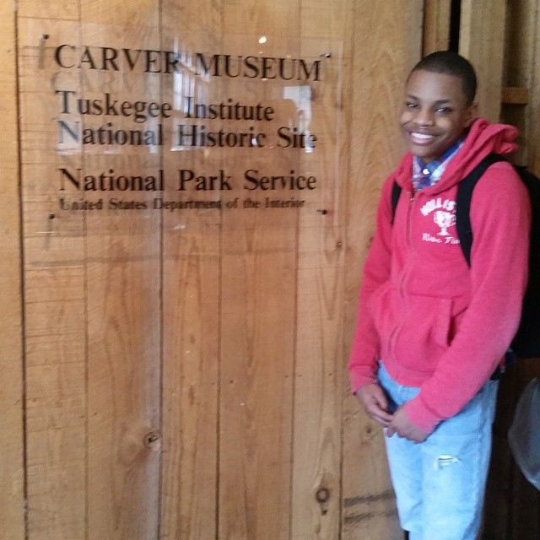
Motivational presentation
Javon williams

Slide 2
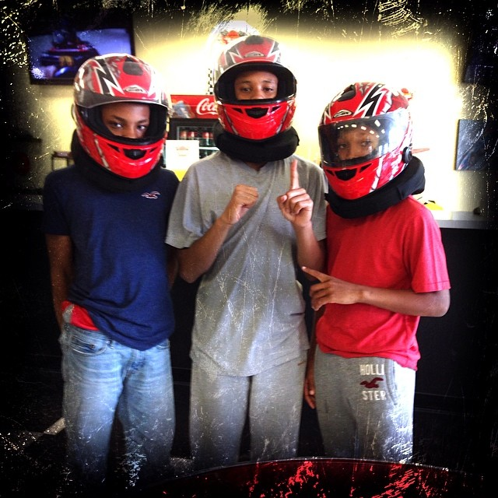
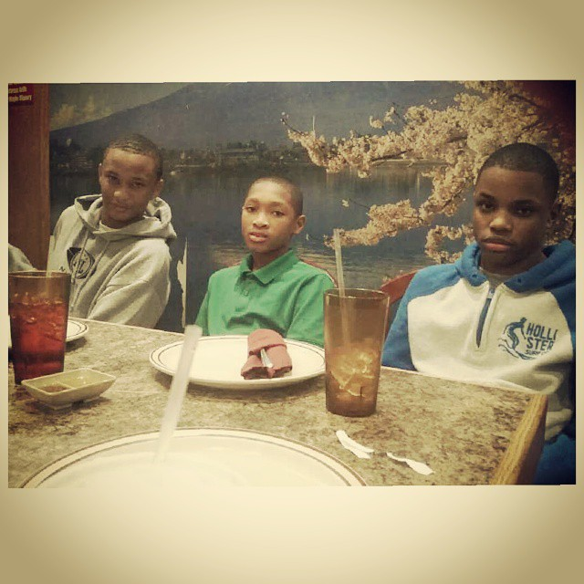
Three Musketeers
Am I my Brother’s keeper yes i am

Slide 3
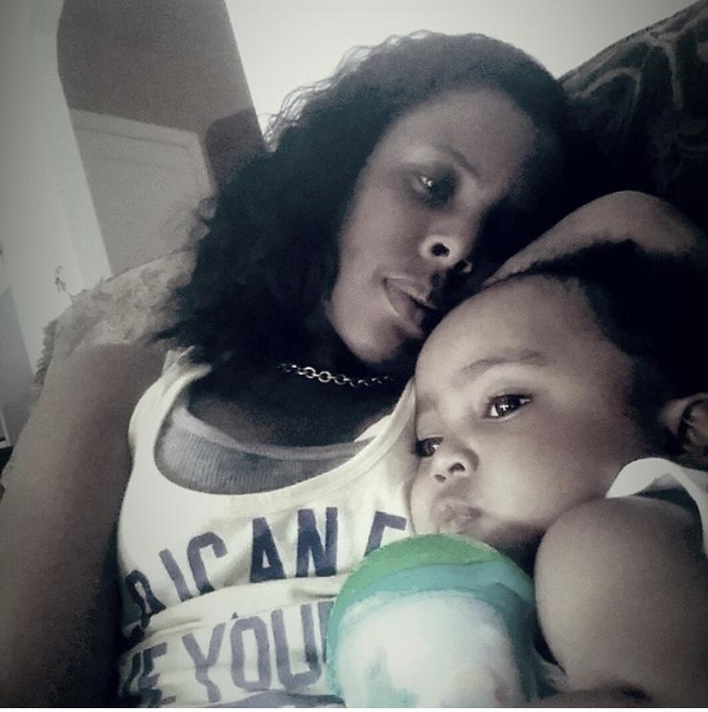
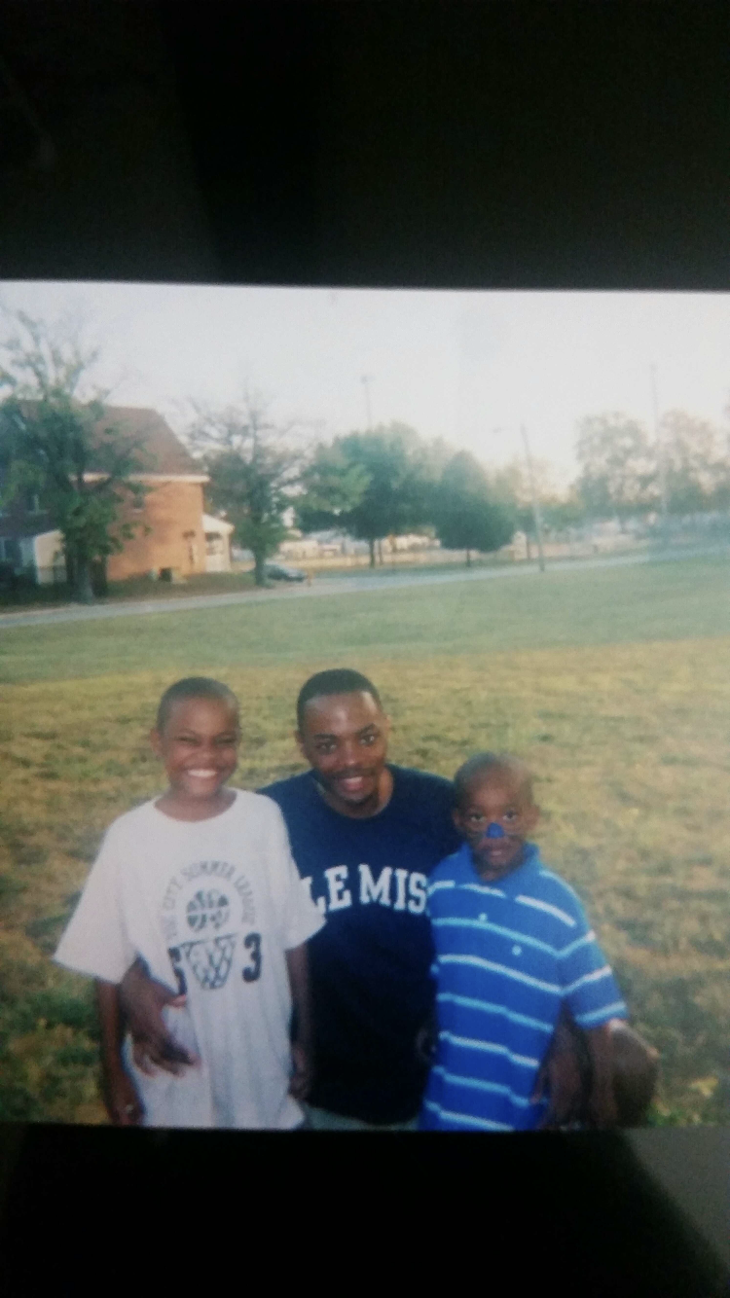
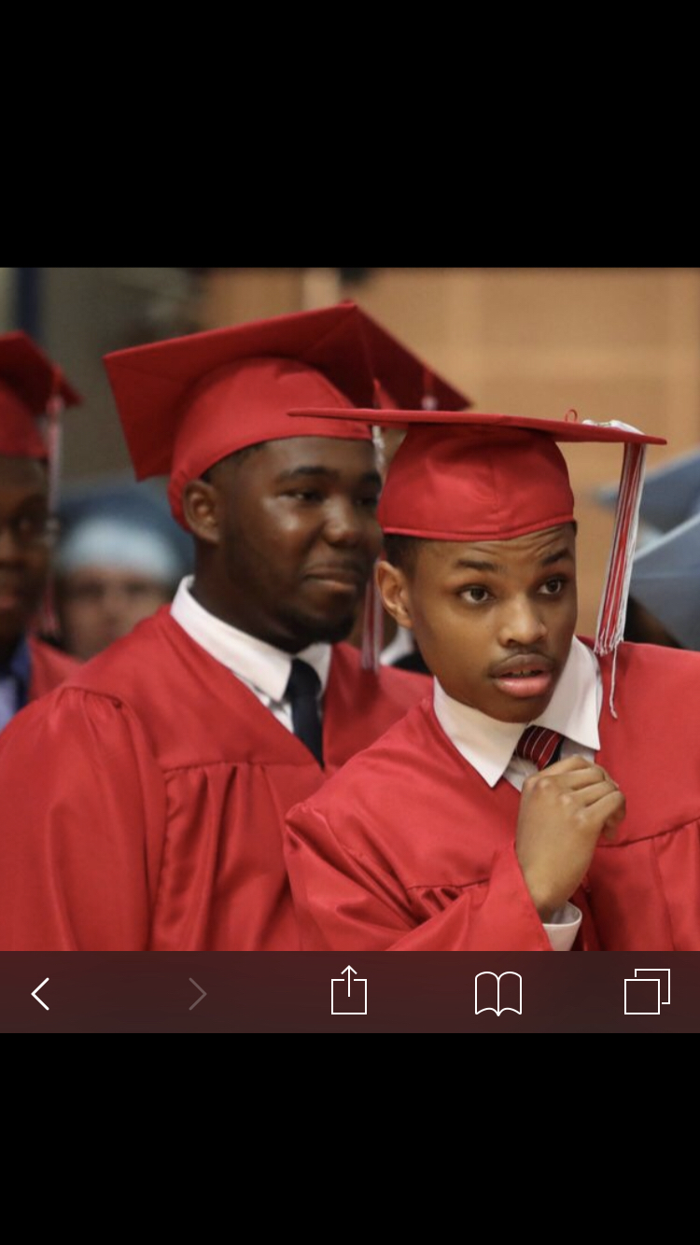
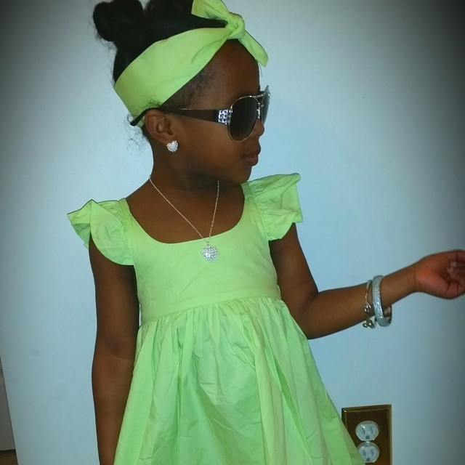
Family and friends
F.O.E = Family Over Everything

Slide 4
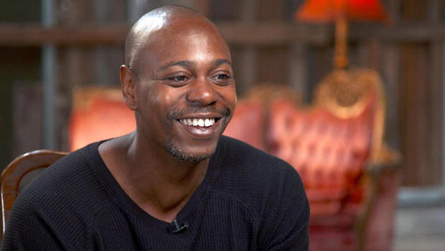
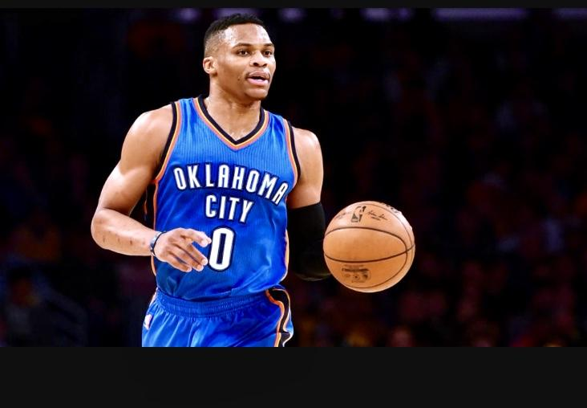
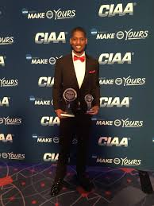
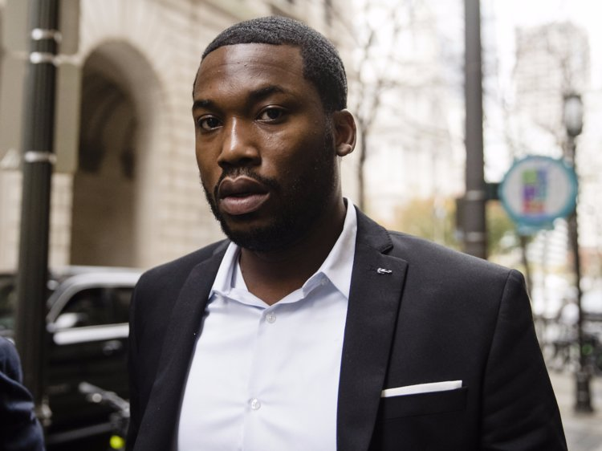
Motivations

Slide 5
Famous Motivational Quotes
“ Why not” From all star of OKC thunder Russell westbrook
“The hardest thing to do is to be true to yourself, especially when everybody is watching”. Dave Chappelle
“I just want to grow spiritually with God. I’m keeping strong at it, just trying to make my walk with faith a little better.” Kevin Durant.
Sometimes I have to remind myself, that on my worst day I live like somebody on their greatest. Meek Mill

